Slide 1
Valuing Progress: Knowledge as a Resource
Jeremy Sheff

Slide 2
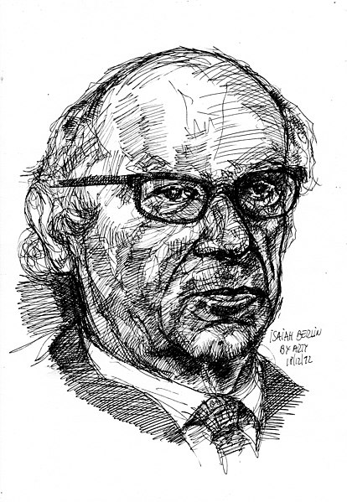
Valuing Progress:
A Pluralist Account of Knowledge Governance
“[H]uman goals are many, not all of them commensurable, and in perpetual rivalry with one another.”
- Isaiah Berlin
Arturo Espinoza, CC-BY-2.0 https://flickr.com/photos/40683483@N07/8284855889

Slide 3
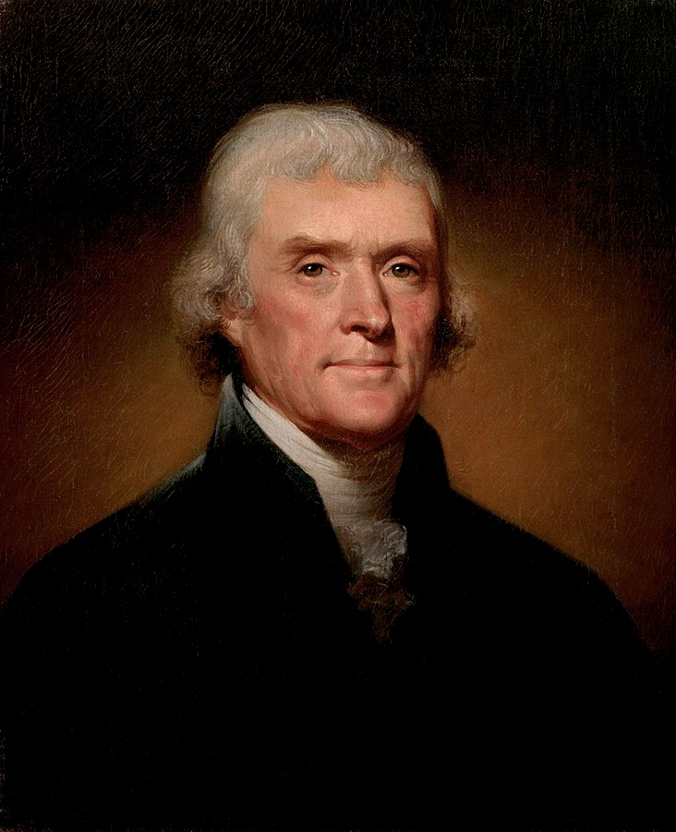
Jefferson’s Taper
“If nature has made any one thing less susceptible than all others of exclusive property, it is the action of the thinking power called an idea, which an individual may exclusively possess as long as he keeps it to himself; but the moment it is divulged, it forces itself into the possession of every one, and the receiver cannot dispossess himself of it. Its peculiar character, too, is that no one possesses the less, because every other possesses the whole of it. He who receives an idea from me, receives instruction himself without lessening mine; as he who lights his taper at mine, receives light without darkening me.”
- Thomas Jefferson
Thomas Jefferson. Source: https://en.wikipedia.org/wiki/Thomas_Jefferson#/media/File:Official_Presidential_portrait_of_Thomas_Jefferson_(by_Rembrandt_Peale,_1800)(cropped).jpg

Slide 4
Jefferson’s Taper
Nonexcludability
  “[T]he moment it is divulged, it forces itself into the possession of every one, and the receiver cannot dispossess himself of it.”
Nonrivalrousness
  “[N]o one possesses the less, because every other possesses the whole of it. He who receives an idea from me, receives instruction himself without lessening mine; as he who lights his taper at mine, receives light without darkening me.”
- Thomas Jefferson
Thomas Jefferson. Source: https://en.wikipedia.org/wiki/Thomas_Jefferson#/media/File:Official_Presidential_portrait_of_Thomas_Jefferson_(by_Rembrandt_Peale,_1800)(cropped).jpg

Slide 5
Public Goods
 | Excludable | Nonexcludable
Rivalrous | Private Goods | Common Pool Resources
Nonrivalrous | Club Goods | Public Goods

Slide 6
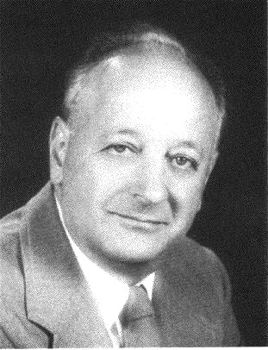
Excludability and resource allocation
“Given the ability to exclude nonpurchasers, private producers can produce public goods efficiently. … [And] the payment of different prices for the same [public] good is consistent with competitive equilibrium … because extending the good to those who value it less does not prevent those who more from using it also.”
Harold Demsetz, The Private Production of Public Goods, 13 J.L. & Econ. 293 (1970).
Harold Demsetz. Source: https://www.hetwebsite.net/het/profiles/demsetz.htm

Slide 7
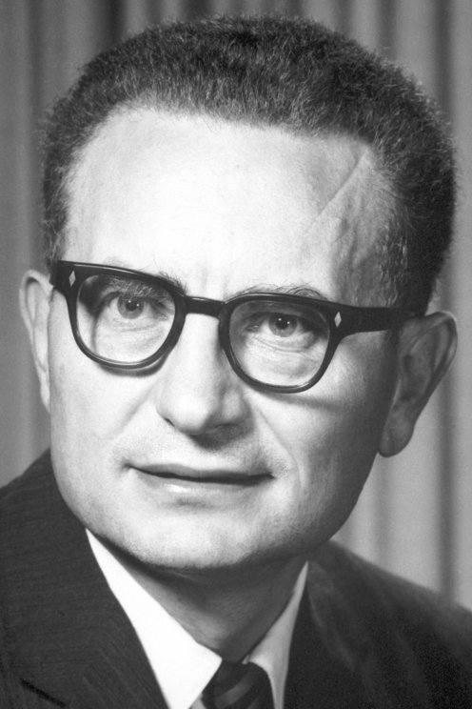
NonRivalrousness and normativity
“If you could find a way of learning when people listen in to the radio, you might apply the exclusion principle to this area. Yet, you would be wrong in discouraging people from getting more satisfaction from listening in an extra hour when there is no true cost to society of their listening in that extra hour.”
Paul Samuelson
Source: Samuelson Papers, correspondence, box 54, “Musgrave, Richard, 1945–2007 Box 54.”, quoted in Maxime Desmarais-Tremblay, Musgrave, Samuelson, and the Crystallization of the Standard Rationale for Public Goods, 49 History of Political Economy 59 (2017).
Paul Samuelson. Source: https://www.nobelprize.org/prizes/economic-sciences/1970/samuelson/biographical/

Slide 8
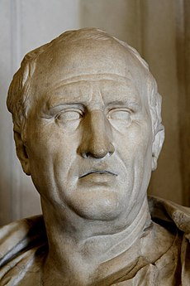
Cicero’s Lumen
“[We should] bestow even upon a stranger what it costs us nothing to give. … On this principle we have the following maxims: …“Let anyone who will take fire from our fire;” “Honest counsel give to one who is in doubt”; for such acts are useful to the recipient and cause the giver no loss.”
Marcus Tullius Cicero, De Officiis I.52
Marcus Tullius Cicero. Source: Jbribeiro1, https://commons.wikimedia.org/wiki/File:Bust_of_Cicero_(1st-cent._BC)_-_Palazzo_Nuovo_-_Musei_Capitolini_-_Rome_2016.jpg

Slide 9
Distributive justice and resources
Normative evaluation of the allocation of benefits and burdens across members of society
Access to resources is generally experienced as a benefit
Deprivation of resources is generally experienced as a burden

Slide 10
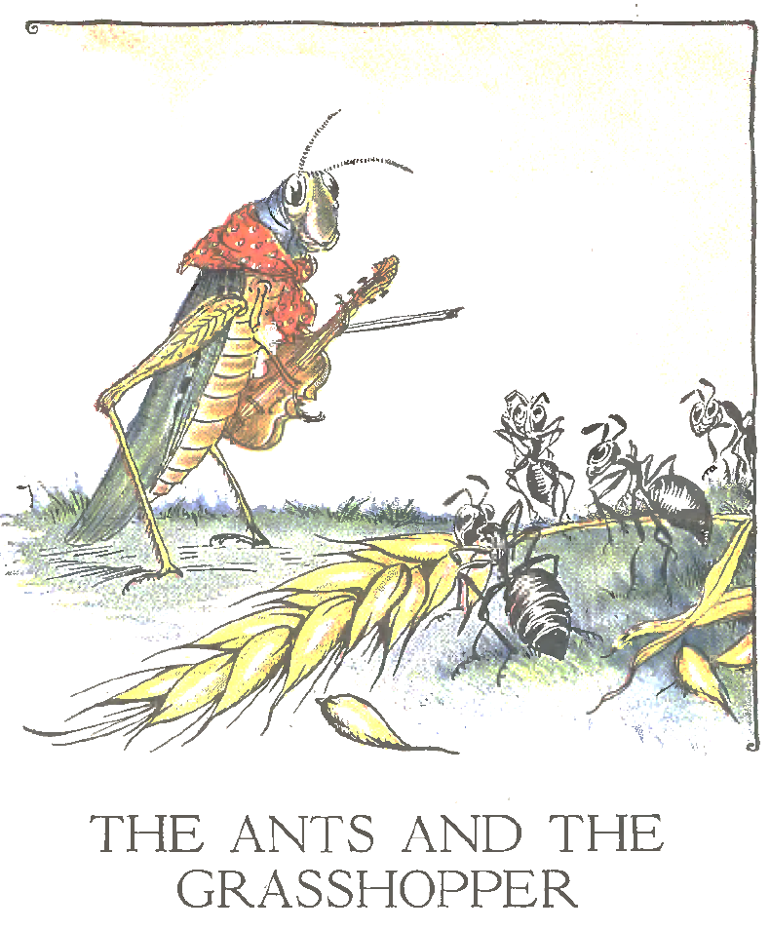
Norms of distributive justice
Political Equality:
  All else equal, all human beings have an equal claim to the benefits of social life, and an equal obligation to undertake its burdens.
Responsibility:
  Any unequal benefits or burdens people experience should not be a function of brute luck, but of their own choices and actions.
Source: Milo Winter, The Ants and the Grasshopper, in The Aesop for Children 34 (1919).

Slide 11
Maintaining just distributions: Reciprocity
Assume that benefits for some agents correlate with burdens for other agents: if I give you a loaf of bread, I lose a loaf of bread.
Under this assumption, when agents return good for good and ill for ill, the baseline norm of political equality is maintained.
The assumption generally holds for the benefits and burdens associated with scarce, tangible resources (i.e., private goods).

Slide 12
Normatively relevant Characteristics of knowledge
Knowledge Production is Costly: it burdens the creator, but benefits nobody else.
Knowledge Transfer is Costless: it benefits the recipient, but does not burden the giver.
The burdens and benefits of knowledge creation and distribution are not correlated.
 | Knowledge Creation | Knowledge Transfer | Private Good Transfer
Burden on Creator/Giver? | Yes | No | Yes
Benefit to Non-Creator/Recipient? | No | Yes | Yes

Slide 13
Two modes of reciprocity
Compensation: The obligation to reciprocate is a function of the burden on the giver, such that we should measure it by the cost borne.
Gratitude: The obligation to reciprocate is a function of the benefit to the recipient, such that we should measure it by the value received.
The two modes coincide for scarce, tangible goods (particularly when mediated by markets).
The two modes conflict for knowledge. If we adhere to one, we violate the other.
 | Knowledge Creation | Knowledge Transfer | Private Good Transfer
Compensation | Obligation | No obligation | Obligation
Gratitude | No obligation | Obligation | Obligation

Slide 14
Implications for evaluation of knowledge governance
If our norms of distributive justice are grounded in the characteristics of scarce, tangible resources, they will generate paradoxes when we apply them to knowledge.
Conflating knowledge creation with knowledge distribution obfuscates but does not eliminate these paradoxes.
Institutions that enforce norms of distributive justice in the context of scarce, tangible resources (such as markets) may violate those norms in the context of knowledge.

