Slide 1
Early Data on TMA Proceedings
(December 2021-February 2024)
TMSR 2024 - UNLV
Jeremy Sheff

Slide 2
TMA Proceedings: Expungement & Reexam
16a Expungements:
  Expungement “on the basis that the mark has never been used in commerce on or in connection with some or all of the goods or services recited in the registration.”
16b Reexamination:
  Cancellation “on the basis that the mark was not in use in commerce on or in connection with some or all of the goods or services recited in the registration on or before the relevant date.”
  Relevant Date:
    For 1(a) use-based applications, the application date (unless filing basis later amended to 1(b))
    For 1(b) intent-to-use applications, the date when the statement of use was filed (or the deadline for filing a statement of use)

Slide 3
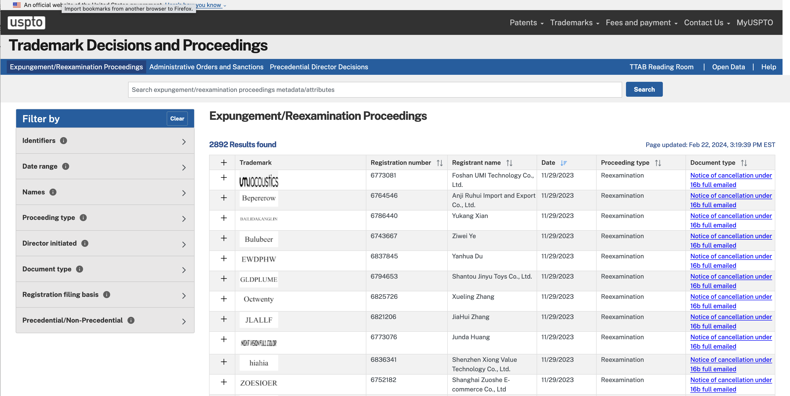
Trademark Decisions and Proceedings Search
https://developer.uspto.gov/tm-decisions/search/expungement

Slide 4
Raw Numbers – 16a Expungements
Director-Initiated | 33 |  |  | Partial Expungement | 1
 |  |  |  | Full Expungement | 7
Non-Director-Initiated | 771 | Not Instituted | 80
 |  | Instituted | 122 | Partial Expungement | 32
 |  |  |  | Full Expungement | 42

Slide 5
Filing Bases– 16a Expungements
Director-Initiated | Filing Basis | Number of Proceedings
 | 44(e) | 15
 | 1(a) | 14
 | 66(a) | 4
Non-Director-Initiated | Filing Basis | Number of Proceedings
 | 1(a) | 381
 | 66(a) | 233
 | 44(e) | 149
 | 1(a), 44(e) | 7

Slide 6
Raw Numbers – 16b Reexaminations
Director-Initiated | 1134 |  |  | Partial Cancellation | 4
 |  |  |  | Full Cancellation | 304
Non-Director-Initiated | 954 | Not Instituted | 92
 |  | Instituted | 140 | Partial Cancellation | 19
 |  |  |  | Full Cancellation | 57

Slide 7
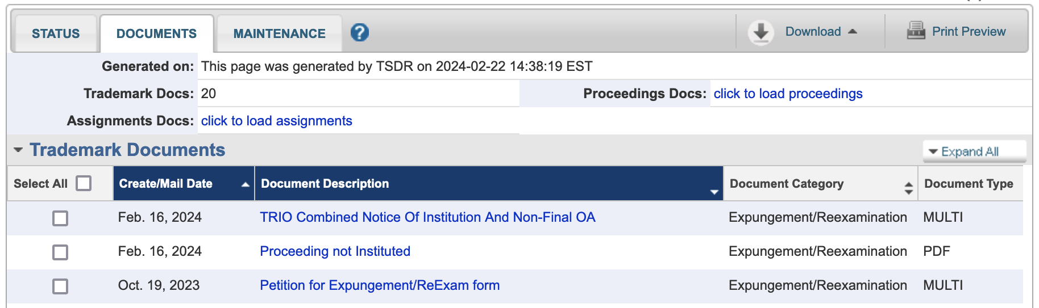
USPTO Cleaning Up After Petitioners
(Reg. No 97473128)

Slide 8
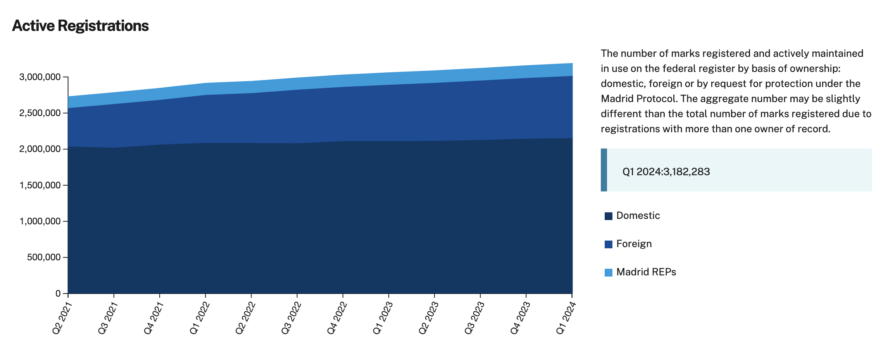
Emptying the Ocean with a Teaspoon
https://www.uspto.gov/dashboard/trademarks/

Slide 9
Emptying the Ocean with a Teaspoon
Percentage of responses reviewed that included a deletion
Month/Year | Percentage
December 2023 | 46%
November 2023 | 49%
October 2023 | 49%
September 2023 | 53%
August 2023 | 48%
July 2023 | 52%
June 2023 | 44%
May 2023 | 44%
April 2023 | 39%
March 2023 | 40%
February 2023 | 46%
January 2023 | 48%
December 2022 | 43%
November 2022 | 50%
October 2022 | 53%
USPTO Post Registration Audit Program Statistics
(https://www.uspto.gov/trademarks/maintain/post-registration-audit-program-statistics)
(audits appx. 5000 registrations per year)
Audit actions to date
Type of action | Nov 2017 - Dec 2023
First office actions issued | 29,022
Registrations with a response deleting goods/services/classes | 49.53%
Total registration cancellations | 3,883
Registrations deleting goods/services/classes
Section 1(a) | 45%
Section 44(e) | 65%
Section 66(a) | 69%
Combined Sections 1(a) and 44(e) | 66%

Slide 10
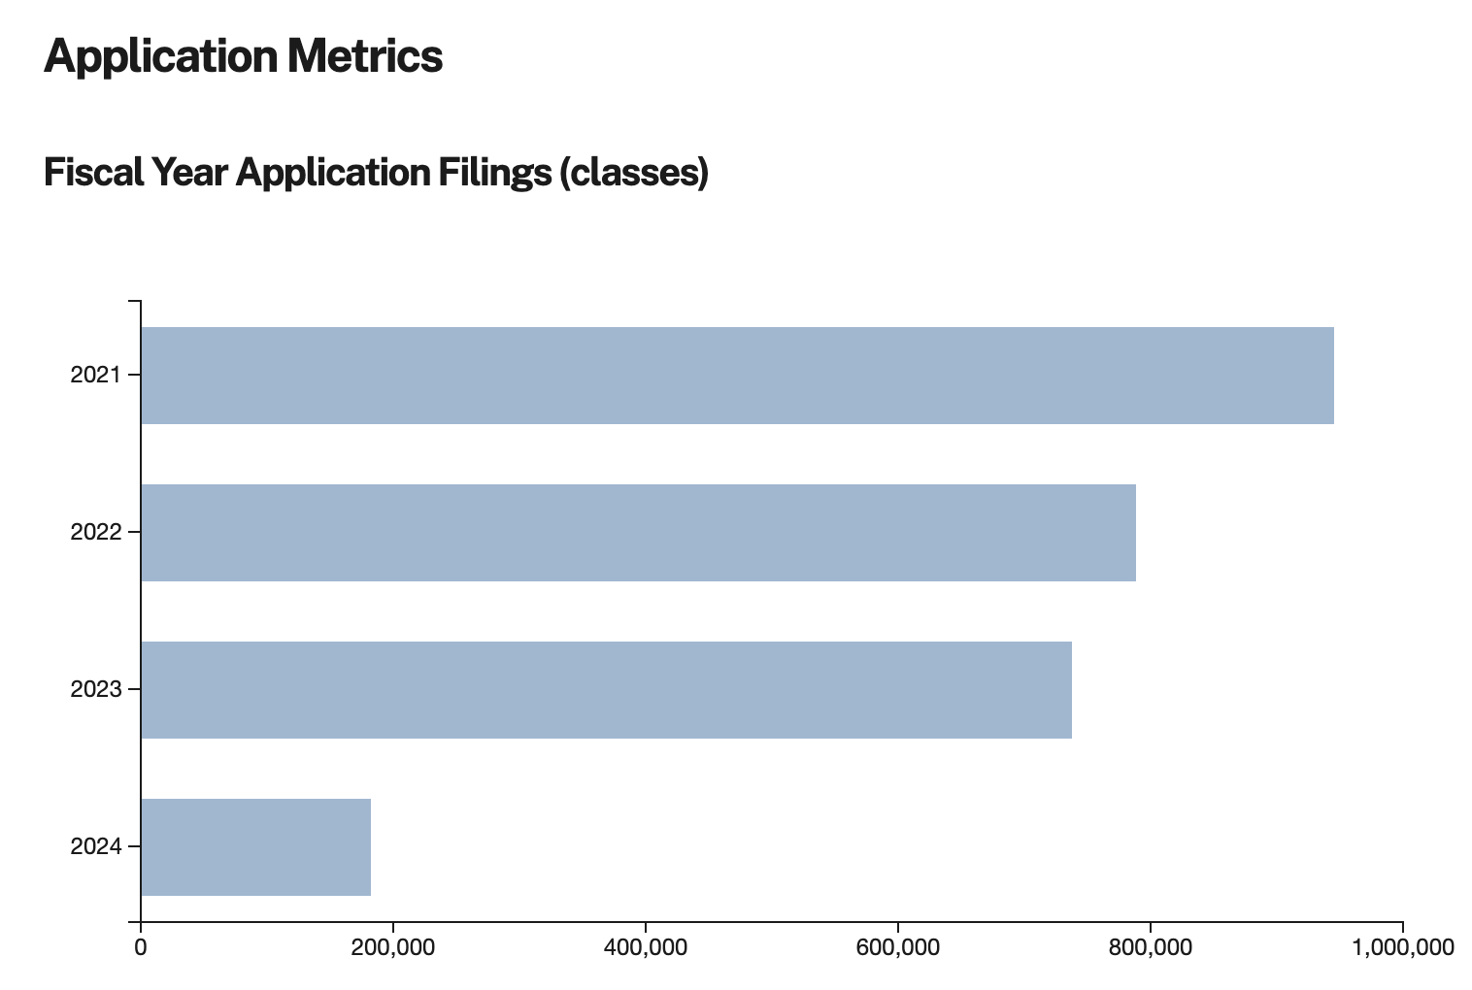
Shoveling Sand Against the Tide
https://www.uspto.gov/dashboard/trademarks/

