Slide 1
An Empirical Evaluation of the Trademark Modernization Act
University of Houston/IPIL - 2024 National Conference in Santa Fe
Jeremy Sheff
St. John’s University

Slide 2
The Problem: Clutter on the Register
Unused registrations raise clearance costs and keep potentially useful marks out of the hands of productive companies
Perverse Incentives Encourage Registration of Unused Marks
  Chinese Government Bounties
  E-Commerce Platform Trademark Registries (esp. Amazon)
The Scope of the Problem
  Random audits of renewal applications find that about half claim the mark for goods on which the registrant isn’t using them, and 10-15% claim a mark that is not being used at all
  Increase in applications from China has become a burden to the examiner corps

Slide 3
TMA Proceedings: Expungement & Reexam
§16a Expungements:
  Expungement “on the basis that the mark has never been used in commerce on or in connection with some or all of the goods or services recited in the registration.”
§16b Reexamination:
  Cancellation “on the basis that the mark was not in use in commerce on or in connection with some or all of the goods or services recited in the registration on or before the relevant date.”
  Relevant Date:
    For 1(a) use-based applications, the application date (unless filing basis later amended to 1(b))
    For 1(b) intent-to-use applications, the date when the statement of use was filed (or the deadline for filing a statement of use)

Slide 4
Who Initiates Proceedings?
 | Director-Initiated | Petitioner-Initiated | Commandeered | Total
Expungement | 1 | 209 | 38 | 248
Reexamination | 714 | 219 | 82 | 1,015
Total | 715 | 428 | 120 | 1,263

Slide 5
Where Do Targeted Registrations Come From?
 | Domestic | Chinese National | Other Foreign National | Multiple Nationalities | No Nationality Data
Director-Initiated | 97 | 606 | 12 | - | -
Petitioner-Initiated | 201 | 111 | 101 | 13 | 2
Commandeered | 48 | 46 | 26 | - | -
Total | 346 | 763 | 139 | 13 | 2

Slide 6
What Happens to Third-Party Petitions?
 | Instituted | Not Instituted | Commandeered | Pending | Total
Expungement | 130 (53%) | 60 (24%) | 38 (15%) | 19 (8%) | 247
Reexamination | 139 (46%) | 56 (19%) | 82 (27%) | 24 (8%) | 301
Total | 269 (49%) | 116 (21%) | 120 (22%) | 43 (8%) | 548

Slide 7
Proceeding Outcomes
 | Petition Still Pending | Proceeding Not Instituted | Instituted but Still Pending | Amended by Registrant | Cancelled | Cancelled In Part | Other | Total
Director-Initiated | 0 (0%) | 0 (0%) | 392 (55%) | 1 (0%) | 302 (42%) | 0 (0%) | 20 (3%) | 715
Petitioner-Initiated | 41 (10%) | 114 (27%) | 59 (14%) | 11 (3%) | 119 (28%) | 51 (12%) | 33 (8%) | 428
Commandeered | 0 (0%) | 0 (0%) | 31 (26%) | 0 (0%) | 61 (51%) | 16 (13%) | 12 (10%) | 120
Total | 41 (3%) | 114 (9%) | 482 (38%) | 12 (1%) | 482 (38%) | 67 (5%) | 65 (5%) | 1,263

Slide 8
How Long Does All This Take?
 | Director-Initiated | Petitioner-Initiated | Commandeered | Total
N | 715 (57%) | 428 (34%) | 120 (9.5%) | 1263 (100%)
Time from Petition to Rejection (in days) | - - - | 69 (35) [n=116] | 94 (81) [n=120] | 82 (64) [n=236]
Time from Petition to Institution (in days) | - - - | 86 (57) [n=269] | 147 (122) [n=120] | 105 (87) [n=389]
Time from Institution to Termination (in days), Opposed | . (.) [n=0] | 231 (150) [n=59] | 277 (82) [n=11] | 238 (142) [n=70]
Time from Institution to Termination (in days), Unopposed | 112 (34) [n=321] | 126 (46) [n=151] | 124 (50) [n=78] | 118 (40) [n=550]
Time from Registrant's Response to Termination (in days) | . (.) [n=0] | 148 (135) [n=59] | 187 (109) [n=11] | 155 (131) [n=70]
Age of Pending Petitions (in days) | . (.) [n=0] | 65 (47) [n=43] | . (.) [n=0] | 65 (47) [n=43]
Age of Pending Proceedings (in days) | 117 (110) [n=391] | 180 (177) [n=59] | 209 (215) [n=31] | 131 (132) [n=481]

Slide 9
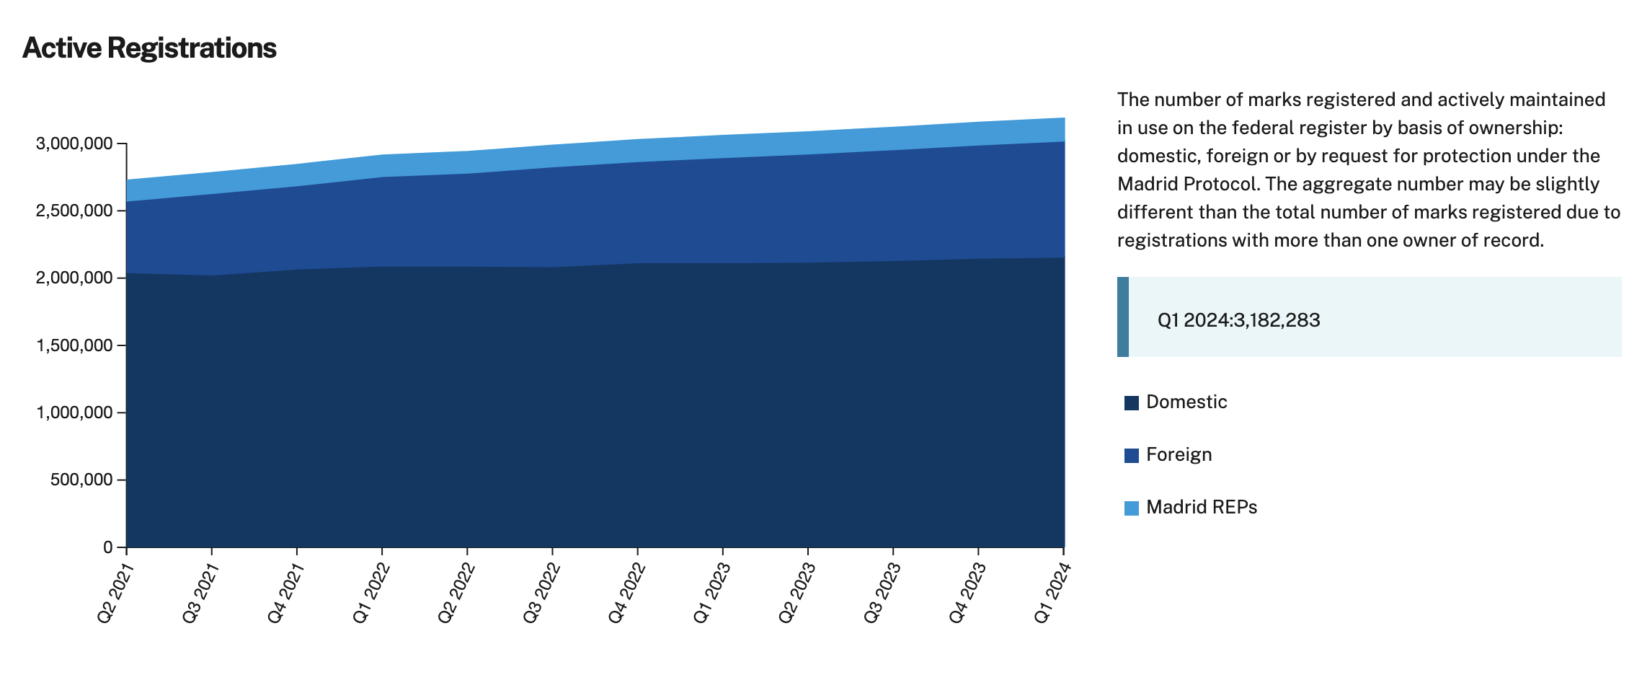
Emptying the Ocean with a Teaspoon
https://www.uspto.gov/dashboard/trademarks/

Slide 10
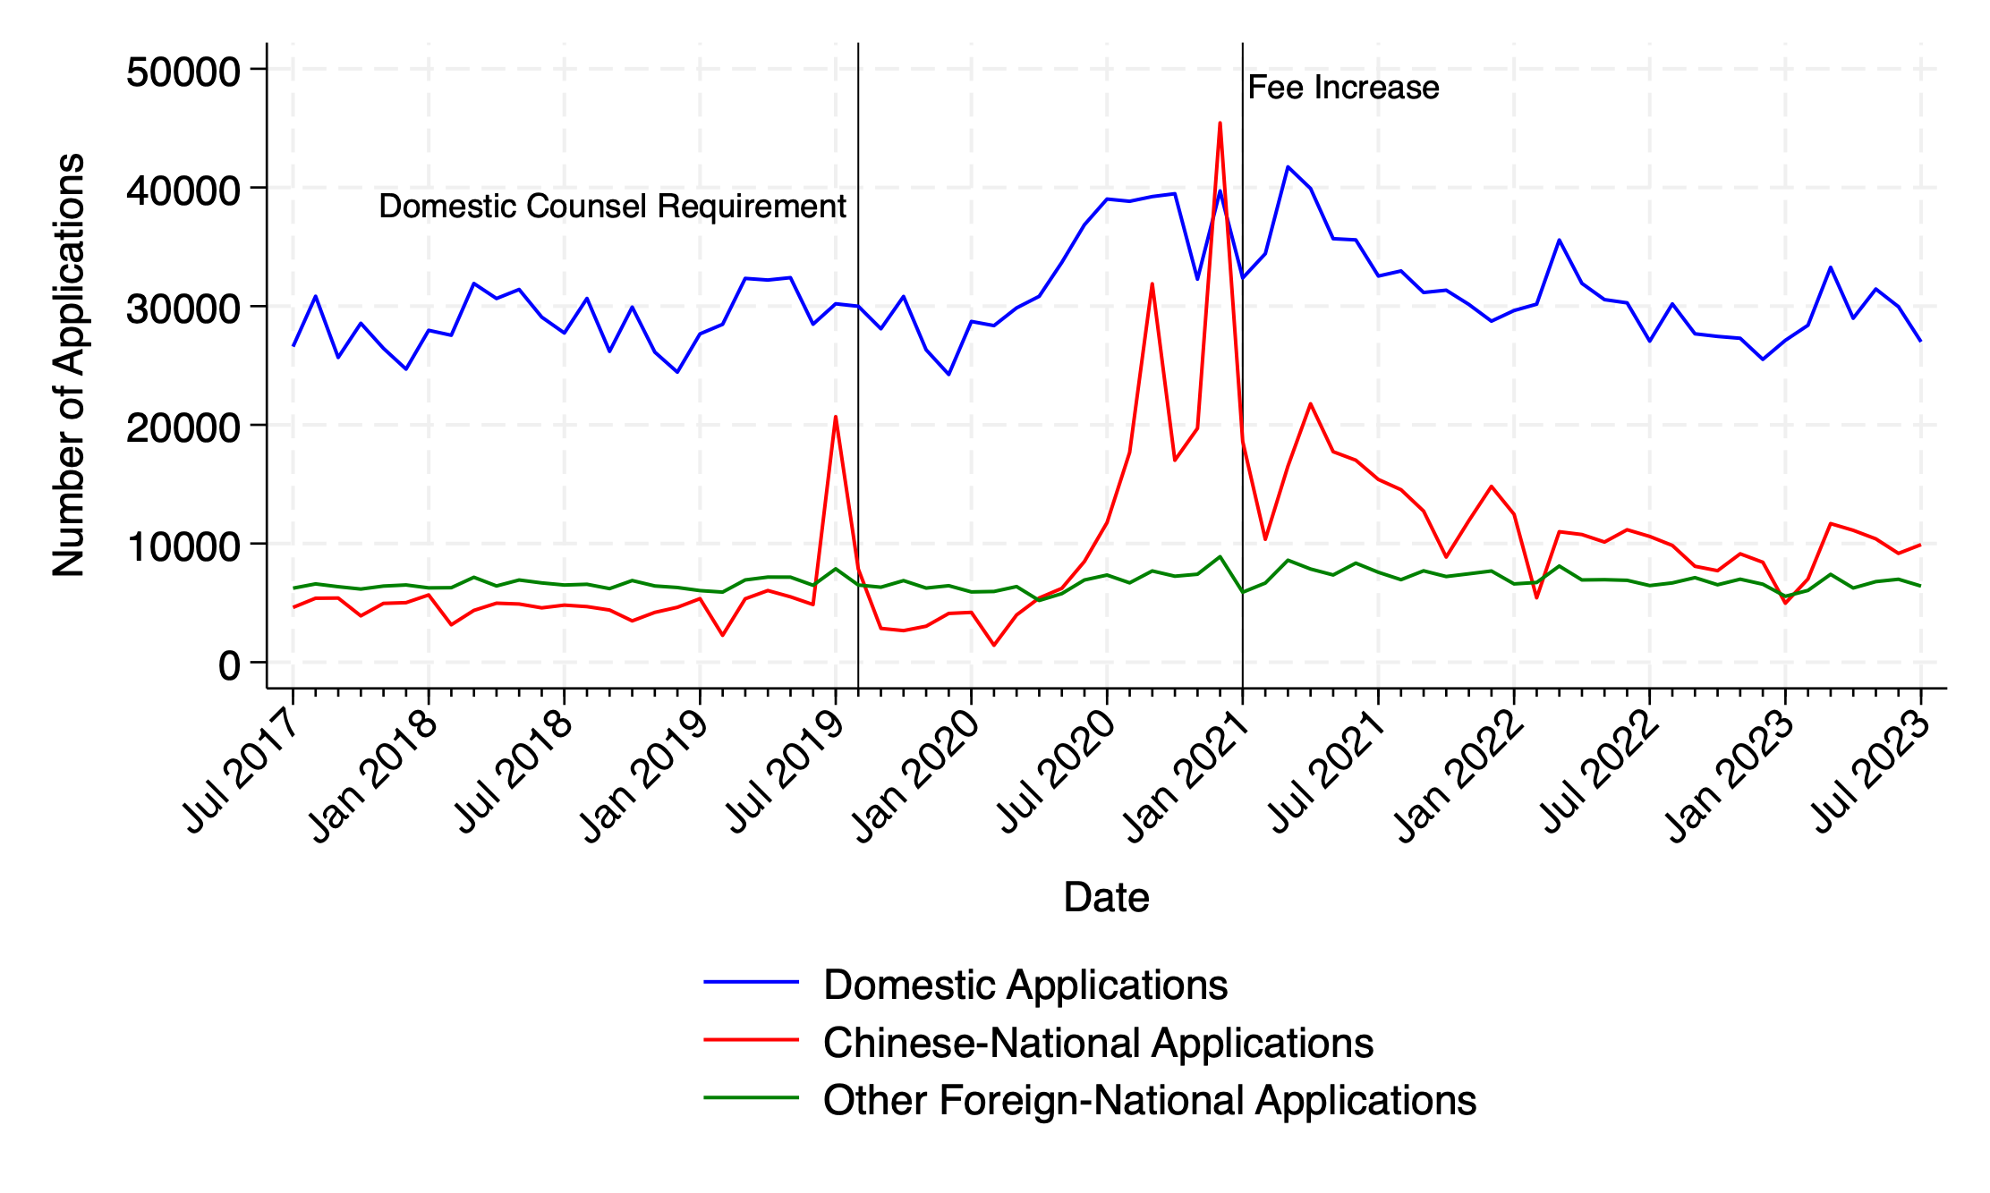
Is There Any Way of Avoiding This?

Slide 11
Clutter Is Cheap to Create and Costly to Remove
Institutional Responses exacerbate the problem
  A TEAS Plus application to register a trademark costs $250 per class
  A Petition to Institute a TMA proceeding costs $400
Making clutter costlier to create imposes costs on everybody, not just the clutterers

Slide 12
Of Automation and Perverse Incentives
There are broad incentives to create clutter; these incentives scale
  Algorithmic enforcement and positioning on e-commerce platforms
  Chinese government bounties (now largely defunct)
The incentives to remove clutter are narrow and don’t scale
  A fishy-looking hit in a clearance search
  A priority contest between competitors
  An examiner discovering a specimen farm
Automation creates this asymmetry—and with it opportunities for bad-faith manipulation—when information is important to human beings who use the automated system but invisible to the machines that run it.

